Slide 1
Diagnostic accuracy

Slide 2
Diagnostic accuracy studies
Two types of studies are used to evaluate the accuracy of a diagnostic test:
Case control studies analyse results from tests done in two separate groups:
cases who have the condition being tested, and
controls who do not have the condition
Case-control studies measure sensitivity and specificity, technical diagnostic accuracy
Cohort studies analyse results from tests done in one group, the cohort
Cohort studies measure sensitivity and specificity, as well as positive predictive value and negative predictive value, clinical diagnostic accuracy

Slide 3
Case-control studies for evaluating diagnostic tests
Case-control studies are useful in early stages of developing a diagnostic test: it is easier and cheaper to obtain samples from people who have already been identified as having or not having the condition
Case-control studies measure sensitivity and specificity (technical diagnostic accuracy)
Case-control studies cannot measure positive and negative predictive values (clinical diagnostic accuracy)
Group by condition status
Group by condition status (for denominator)
Cases (with the condition)
TP: Test result +ve
TP
Sensitivity = TP / (TP + FN)
FN: Test result -ve
FN
Group by condition status
Group by condition status for denominator
Controls (without the condition)
FP: Test result +ve
FP
TN
Specificity = TN / (FN + TN)
TN: Test result -ve
Sensitivity and specificity are characteristics of the test, not the population

Slide 4
Cohort studies for evaluating diagnostic tests
Cohort studies are useful in the later stages of developing a diagnostic test because they allow positive and negative predictive values to be measured, as well as sensitivity and specificity.
Cohort studies evaluate both technical and clinical accuracy.
Group by condition status
Group by condition status (for denominator)
With the condition
TP: Test result +ve
TP
Sensitivity = TP / (TP + FN)
FN: Test result -ve
FN
Without the condition
FP: Test result +ve
FP
TN
TN: Test result -ve
Specificity = TN / (FN + TN)
Sensitivity and specificity are characteristics the test, not the population

Slide 5
Cohort studies for evaluating diagnostic tests
Cohort studies are useful in the later stages of developing a diagnostic test because they allow positive and negative predictive values to be measured, as well as sensitivity and specificity.
Cohort studies evaluate both technical and clinical accuracy.
Group by condition status
Group by test result (for denominator)
With the condition
TP: Test result +ve
TP
Positive predictive value =
TP / (TP + FP)
FN: Test result -ve
FP
FP: Test result +ve
Without the condition
FN
TN
Negative predictive value =
TN / (FN + TN)
TN: Test result -ve
Predictive values are characteristics of the test and the population

Slide 6
Acting on the result of a diagnostic test
Because no test is perfect, there is always a chance of a result being misleading.
A person’s rational decision will be to act if the predictive value of the test implies that there is a net benefit from the combined chances and values of good and poor outcomes .
Group by test result
Group by test result
TP
TP: Test result +ve
TP: treat — good outcome likely
FP
FP: Test result +ve
FP: treat — poor outcome likely
FN
FN: Test result -ve
FN: do not treat — poor outcome likely
TN
TN: do not treat — good outcome likely
TN: Test result -ve
Treatment decisions depend on the likelihoods of the outcomes, and the values placed on them

Slide 7
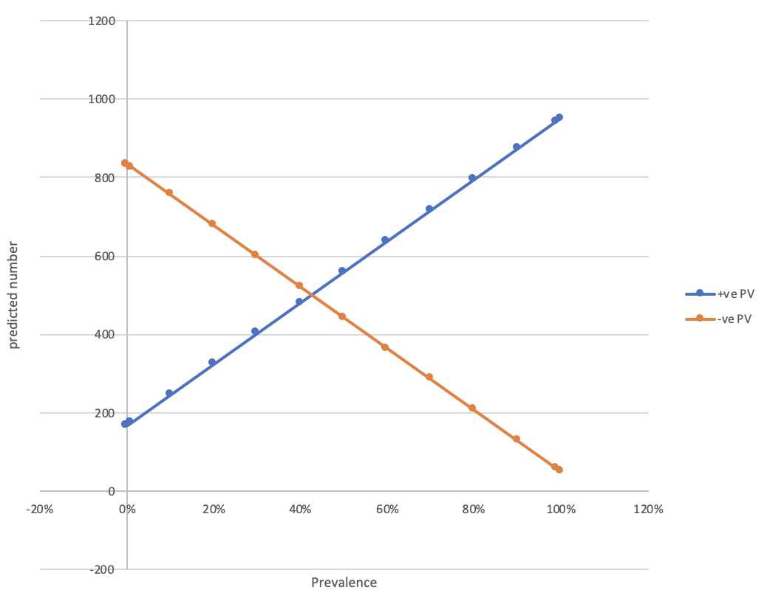
Predictive values depend on sensitivity, specificity, and prevalence

Slide 8
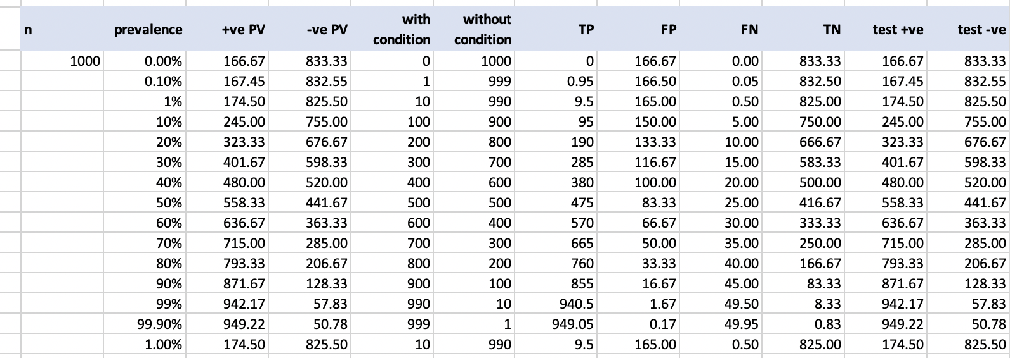
Predictive values depend on sensitivity, specificity, and prevalence

